Slide 1
Context Free Grammar

Slide 2
Today Topics…………
CFG
Parse Tree
Types of Derivation
Left Most Derivation
Right Most Derivation
Types of Grammars

Slide 3
Context Free Grammar
CFGs are used to describe context free languages.
A CFG represents in the form of quadruple
(N, T, P, S)
Where
N: a finite set of variables (“non-terminals”); e.g., A, B, C, …
T: a finite set of symbols (“terminals”), e.g., a, b, c..
P: a set of production rules.
S: a start non-terminal; S ∈ N.

Slide 4
In the text book we use the following conventions regarding grammars.
The capital letters A,B,C,D,E and S denote variables; S is the start symbol unless otherwise stated.
The lower-case letters a,b,c,d,e, digits, special symbols and boldface strings are terminals.
The capital letters X,Y and Z denote symbols that may be either terminals or varibales.
The lower-case letters u,v,w,x,y and z denote strings of terminals.
The lower-case Greek letters α,β and γ denote strings of variables and terminals.

Slide 5
Derivation Tree/Parse Tree
The process of deriving a string is called as derivation.
The graphical representation of a derivation is called as a parse tree or derivation tree.
It represents the Syntactic structure of a string derived from a context-free grammar.

Slide 6
Parse Tree
Represented with
Root vertex −
Must be labelled by the start symbol.
Vertex −
Labelled by a non-terminal symbol.
Leaves −
Labelled by a terminal symbol or ε.

Slide 7
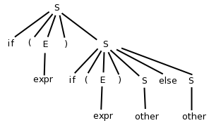
Given the grammar
S → if ( E ) S | if ( E ) S else S
S → other ; E → expr
Construct the parse tree for the above G.
Ans:

Slide 8
Types of Derivations
Derivations are divided in to 2 Types.
1. Left Most Derivation
2. Right Most Derivation

Slide 9
Left Most Derivation
The process of deriving a string by expanding the leftmost non-terminal at each step is called as leftmost derivation.
The geometrical representation of leftmost derivation is called as a
leftmost derivation tree.

Slide 10






Consider the G: S → aB / bA,
S → aS / bAA / a, B → bS / aBB / b.
Derive the parse tree for string “aaabbabbba”.
Sol:
S→ aB
→ aaBB (Using B → aBB)
→ aaaBBB (B → aBB)
→ aaabBB (B → b)
→ aaabbB (B → b)
→ aaabbaBB (B → aBB)
→ aaabbabB (B → b)
→ aaabbabbS (B → bS)
→ aaabbabbbA (S → bA)
→ aaabbabbba (A → a)

Slide 11
Right-Most Derivation
The process of deriving a string by expanding the rightmost non-terminal at each step is called as rightmost derivation.
The geometrical representation of rightmost derivation is called as a
rightmost derivation tree.

Slide 12
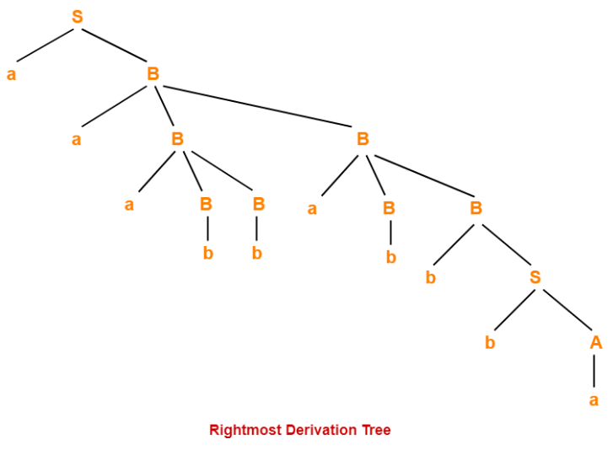
Ex: Consider the Grammar S → aB / bA,
S → aS / bAA / a, B → bS / aBB / b.
Derive the parse tree for string “aaabbabbba”.
A:Now, let us derive the string w using rightmost derivation,
S → aB
→ aaBB (Using B → aBB)
→ aaBaBB (B → aBB)
→ aaBaBbS (B → bS)
→ aaBaBbbA (S → bA)
→ aaBaBbba (A → a)
→ aaBabbba (B → b)
→ aaaBBabbba (B → aBB)
→ aaaBbabbba (B → b)
→ aaabbabbba (B → b)

Slide 13
Ex2:Consider the grammar E → E + E|E * E|id and verify the input string id+id*id is acceptable or not.
Sol: LMD:
E → E * E
E → E + E * E
E → id + E * E
E → id + id * E
E → id + id * id
RMD:
E → E + E
E → E + E * E
E → E + E * id
E → E + id * id
E → id + id * id

Slide 14
Types of Grammars
Depending on Number of Derivation trees, CFGs are sub-divided into 2 types:
Ambiguous grammars → More than one
Unambiguous grammars. → Single Solution

Slide 15
Summary……………
CFG Tuple form
Parse Tree
Types of Derivations
Types of Grammars

Slide 16
Practice example
1. Consider the grammar S->(L)|a, L->L,S|S.
i. What are the Non Terminal's and Terminals and start symbol.
ii. Draw the parse tree for the following
1. (a,a) 2. (a,(a,a)) 3. (a,((a,a),(a,a)))

Slide 17
Writing a Grammar
Elimination of Ambiguity
Elimination of Left Recursion
Elimination of Left Factoring

Slide 18
1. Elimination of Ambiguity
Ambiguous if there exists more than one derivation tree for the given input string
If the grammar has ambiguity, then it is not good for compiler construction.
Avoids ambiguity by re-writing the whole grammar without ambiguity.

Slide 19
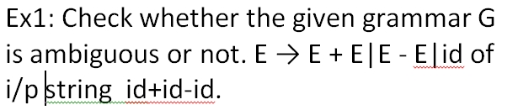
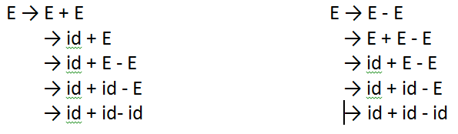
Ans:
Since there are two leftmost derivation for a single string "id + id - id", the grammar G is ambiguous.

Slide 20
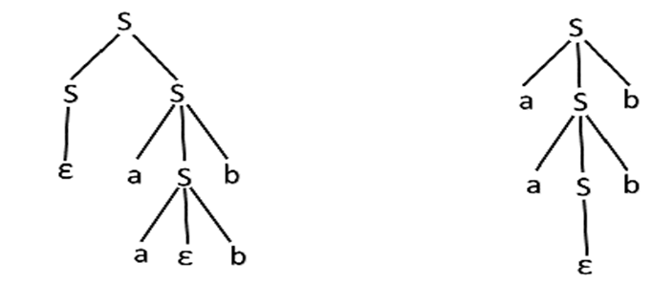
Ex2: Check whether the given grammar G is ambiguous or not. S → aSb | SS, S → ε.
Ans: For the string "aabb" the above grammar can generate two parse trees.
Since there are two parse trees for a single string "aabb", the grammar G is ambiguous.

Slide 21
2. Elimination of Left Recursion :
If the grammar consists of same non terminal symbol in both sides.
Symbolically,
A → A α | β
where β does not start with A
⇓ eliminate immediate left recursion
A → β A’
A’ → α A’ | ε an equivalent grammar

Slide 22
Elimination of Left Recursion :
A → A α1 |A α2 |β1 |β2 …. ..
⇓ eliminate immediate left recursion
A → β1 A’ | β2 A’ … ….. βn A’
A’ → α1 A’ | α2 A’ … …. αn A’ |ε
an equivalent grammar

Slide 23
S ->aB|aC|Sd|Se➔ S ->Sd|Se|aB|aC
Compare A → A α1 |A α2 |β1 |β2
Where A=S; α1 =d; α2 =e ; β1 =aB; β2=aC.
Replace by A → β1 A’ | β2 A’
A’ → α1 A’ | α2 A’|ϵ
S→aBS’|aCS’
S’→dS’|eS’| ϵ.
L.F➔S→aS’’
S’’→BS’|CS’

Slide 24
S→aS’’
S’’→BS’|CS’
S’→dS’|eS’|ϵ
B→bBc | f
C→ g

Slide 25
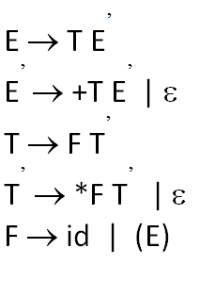
Check whether the given grammar is
left recursive or not. E → E+T|T,
T → T*F|F, F → id|(E).
Ans: In the above grammar first 2 productions both sides are starts with same Non Terminal symbols (E and T).
So apply the L-Recursion,
E→E+T|T
Compare by A→Aα | β where A=E , α=+T and β=T.
Substitute the terms in the formula
A→βA’; A’→αA’|ϵ
∴ E→TE’ and E’→+TE’| ϵ.
Apply same procedure for second production, then the production becomes

Slide 26
3. Elimination of Left Factoring:
The productions start with the same terminal (or set of terminals).
A grammar is said to be left factored when it is of the form –
A -> αβ1 | αβ2 | αβ3 | …… | αβn
The equivalent left factored grammar will be – A -> αA’ A’ -> β₁ | β₂ | β₃ | …… | β_{n}

Slide 27
Ex1: Verify the G is left factor or not,
S → iEtS / iEtSeS / a, E → b.
Sol: The above G is in L-Factor because of comman term ”iEtS” in 2 productions.
S→iEtS|iEtSeS is compares with
A -> αβ1 | αβ2 Here A=S; α = iEtS ; β1= ϵ; β2=eS.
Substitute it on A -> αA’ | ϵ A’ -> β1 | β2.....
∴ S→iEtSS’
S’→ ϵ|eS
The grammar is-
S → iEtSS’ / a
S’ → eS / ∈
E → b

Slide 28
Ex2: Verify the G is left factor or not,
A → aAB / aBc / aAc.
Sol: The left factored grammar is-
Phase 1: A → aA’
A’ → AB / Bc / Ac
Again, this is a grammar with common prefixes.
Phase 2: A → aA’
A’ → AD / Bc
D → B / c

Slide 29
Ex3: Verify the G is left factor or not,
S → a / ab / abc / abcd.
Sol: The left factored grammar is-
Phase 1: S → aS’
S’ → b / bc / bcd / ∈
Again, this is a grammar with common prefixes.
Phase 2: S → aS’
S’ → bA / ∈
A → c / cd / ∈
Again, this is a grammar with common prefixes.
Phase 3: S → aS’
S’ → bA / ∈
A → cB / ∈
B → d / ∈

